Slide 1
VIZ1, Session 6
Effective Communication in Visualizations

Slide 2
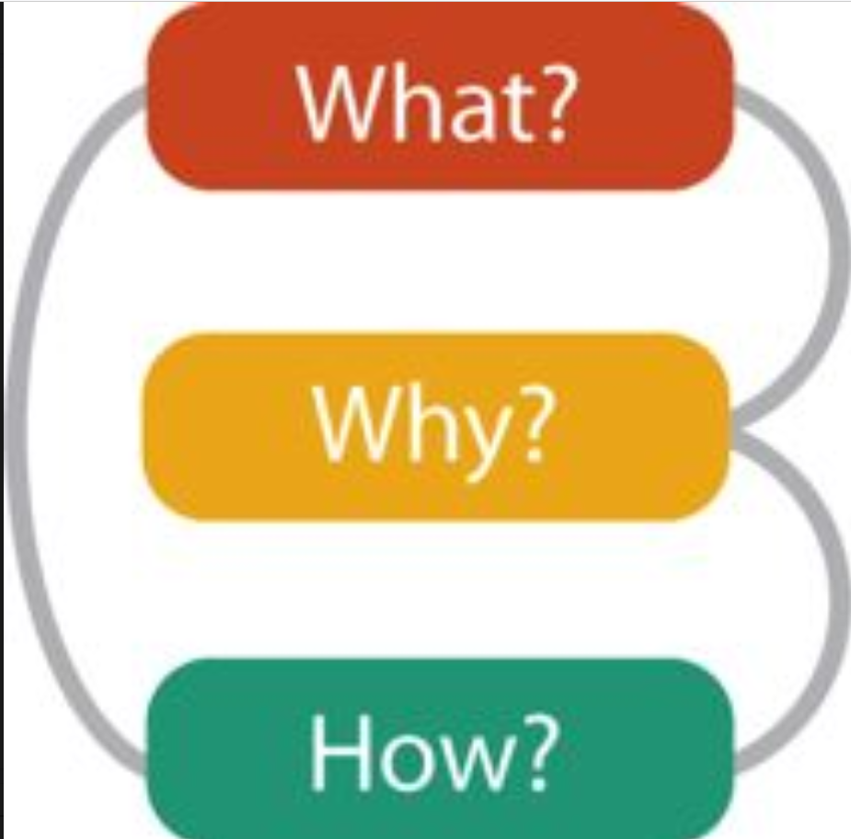
The what, the why, and the how

Slide 3

Marks and Channels (I)
Marks - the base shapes
  0D: points
  1D: lines
  2D: areas – Squares, Circles, etc.
  3D: volumes (rarely)
In D3.js, marks are encoded as SVG elements

Slide 4
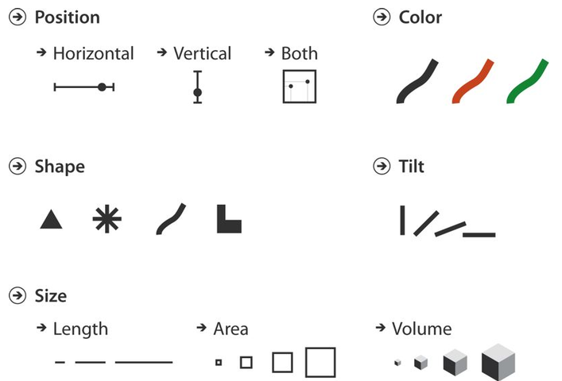
Marks and Channels (II)
Controls the appearance of the marks
In D3.js, marks are encoded as SVG attributes using scales

Slide 5
Marks and Channels (III)

Slide 6
Channel effectiveness
Not all channels are effective for all attribute types
Ordered attributes
  If sequential, needs a low point
  If diverging, needs a centre point
  If cyclical, needs a way to illustrate that low and high point are the same
Categorical attributes
  Needs to identify categories
On top of that, research has shown that some channels are inherently more effective than others

Slide 7
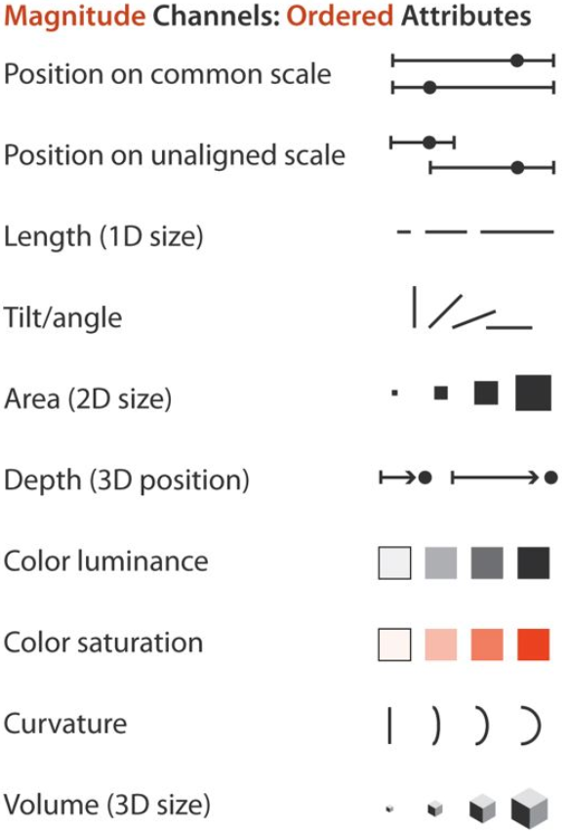
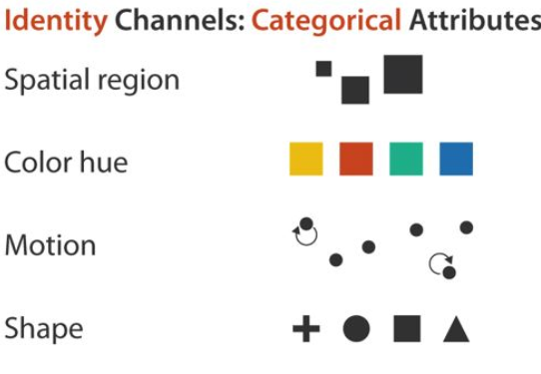
Channels in order of effectiveness (high to low)

Slide 8
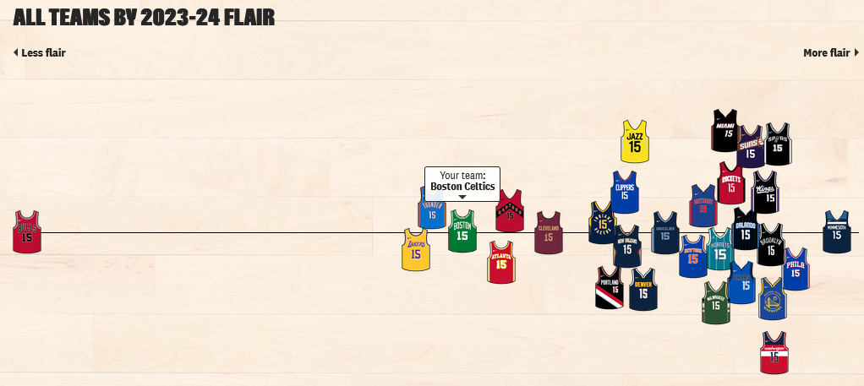
Break and discussion
In this visualization, identify
  Marks
  Channels
Rank the channels by effectiveness
Source: https://pudding.cool/2024/10/nba-uniforms/

Slide 9
The colour channels
The colour channels are
  Hue
  Saturation
  Luminance
How we perceive colour is determined by
  Our retina
  Out brain
RGB does little to help here

Slide 10
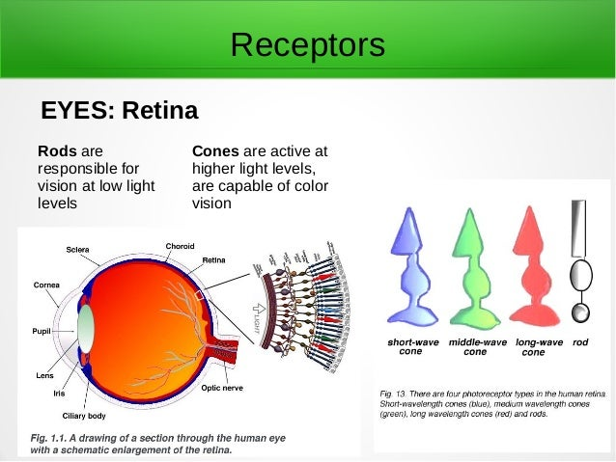
The retina

Slide 11
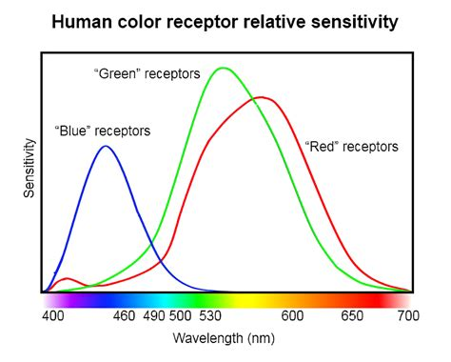
Short (S), Medium (M), and Long (L) Cones

Slide 12
Colour spaces
RGB is a trick:
  Stimulates the cones with certain intensities
  Your brain thinks it's seeing a particular colour
HSV/HSL is closer to the perceived colour
  Hue is the primary colour – what a child would call the colour
  Saturation is how strong the colour is: 0 saturation: grayscale
  Value/lightness is how bright the colour is (0 = black)
    Maximum value: The pure colour
    Maximum lightness: White

Slide 13
Luminance
Hue and saturation is how we see
Lightness and value don't
Note yellow on the diagram
It hits almost peak on both M- and L-cones
We perceive yellow as very bright
This is high luminance

Slide 14
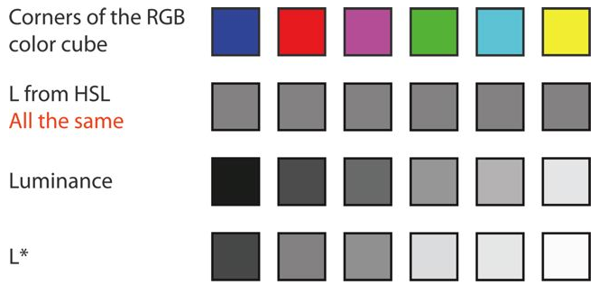
Luminance compared to others

Slide 15
Using colour channels
Saturation
  A channel of middling effectiveness for sequential data
  Works in both colour and black/white
Luminance
  A channel of middling effectiveness for sequential data
  Hard to compute
  Easiest is to stay with the same hue and use value/lightness
Hue
  A channel of high effectiveness for sequential data
  Beware of colour blindness

Slide 16
Colour blindness
Colour blindness is caused by reduction or absence of L-, M-, or S-cones
This effects colour perception of all colours (but some more than others)
1 in 12 men are affected by so-called "red/green" colour blindness
1 in 200 are affected by other forms
1 in 200 women are affected by colour blindness

Slide 17
Types of colour blindness
Type of missing cone(s) | Partial | Full | Colloquial term
None | Trichromatic | Trichromatic | Normal
L-cone | Protanomaly (red-weak) | Protanopia (red-blind) | Red/green colourblind
M-cone | Deuteranomaly (green-weak) | Deuteranopia (green-blind) | Red/green colourblind
S-cone | Tritanomaly (blue-weak) | Tritanopia (blue-blind) | Blue/yellow colourblind
L-cone and S-cone | - | Blue cone Monochromacy | Completely colourblind
All |  | Monochromacy (achromatopsia) | Completely colourblind

Slide 18
Example: d3.schemePaired
(source: https://www.color-blindness.com/coblis-color-blindness-simulator/)
Normal
Red-blind
Green-blind
Blue-blind

Slide 19
How to deal with colour blindness
Know the usage situation
Think twice before using hue
Don't use too many different colours
Use a colour simulator
  Preferably: Use colourblind testers

Slide 20
Popout
One or more visual elements stand out from the others
  A few red elements in a field of green objects
  Moving elements against a backdrop of stationary ones
This works immediately because of our tendency to see images as shapes and patterns
In psychology, this is called "Gestalt"
The "Gestalt Principles" or "Gestalt Laws of Grouping" can help us to design popout.

Slide 21
Gestalt Principles
Similarity
Continuity
Proximity
Closure
Common Fate
Figure-Ground
Symmetry & Order
Prägnanz
Common Region

Slide 22
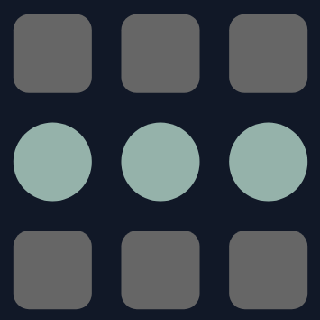
Similarity
Shapes that look alike are grouped together
Note how the middle shapes pop out

Slide 23

Continuity
Objects on a smooth curve seem to go together
Here, the objects on the top pop out from the others

Slide 24

Proximity
Objects that are close together seems to belong to the same group

Slide 25

Closure
Our brain "connects the dots" to complete shapes
Notice the triangle that isn't really there
Use this to subtly create groupings among elements

Slide 26

Common Fate
Objects that move together are grouped together
Notice that this is stronger than similarity

Slide 27
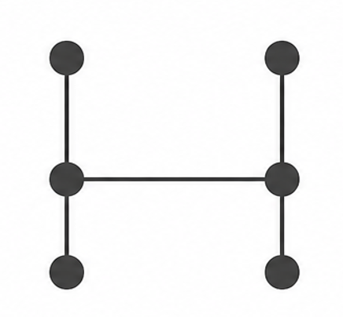
Bonus Principle: Connectedness
Not really a Gestalt principle
We can connect the dots ourselves
Not terribly subtle, but works

Slide 28
Workshop
Continue the design from last time (see the uploaded exercises)

